Slide 1

The Future Generation of Wireless Networks

Slide 2
Introduction: What is 5G?
Definition
Presentation overview:
Comparison of Past technologies
Present technologies
The future of wireless networks
Random change

Slide 3
Where are we today?
Uses:
High-definition video streaming
Multiple video-conferencing
Fast mobile web access
Gaming services
4G wireless networks
Types:
First Release: Evolved High Speed Packet Access - HSPA+ (Voice circuit capabilities)
Second Release: WiMAX (Packet based)
Latest release: LTE – Long Term Evolution (Packet Based)
Features:
Faster speeds (a minimum of 10Mbps and a theoretical speed of 100Mbps)
3kHz-6GHz Bandwidth
Uses Internet-based protocols as opposed to circuit-switching to support high data rates and manage itself and the radio network more efficiently

Slide 4
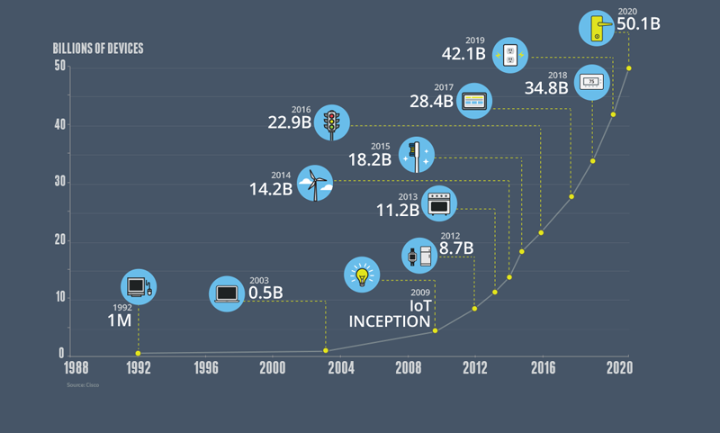
The growth of the internet of things: A need for change
In order to avoid congestion in the network and enjoy even faster speeds, one requires:
Higher bandwidth
Lower end to end latency
Massive device connectivity
Reduced cost
Consistent quality of experience

Slide 5

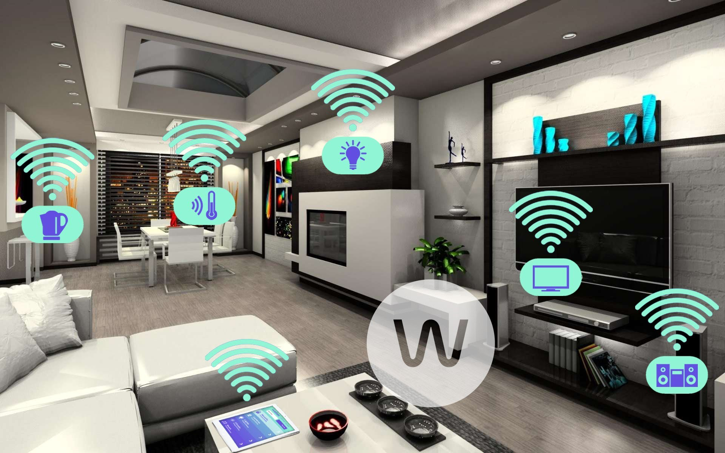

The Solution? 5G technologies
Virtual Reality
Autonomous Driving
The Internet of Things
Big data transfer

Slide 6
Emerging Technologies for 5G networks
Millimetre Waves
Small Cells
Massive MIMO
Beamforming
Full Duplex

Slide 7
Techniques for improving wireless networking technologies
Improve Bandwidth using millimetre waves
Transmit signals around obstacles by using line-of-sight small cells
Increase number of antennas at cellular base stations (8-12 to over 100)
Create full-duplex communication using silicon transistors as high speed switches
Send device to device (D2D) signals to avoid interference caused by increased MIMO
Notes:
Higher frequencies are more easily absorbed by the atmosphere and can be scattered by the weather events and buildings, thus they require neary line-of-sigt communication.
Increasing MIMO (massive MIMO) would broadcast a lot of signals at once, resulting in increased interference and noise.
The base station uses signal processing algorithms to find the path the data took to arrive to it and uses this information to send its message directly to the host it received it from.

Slide 8
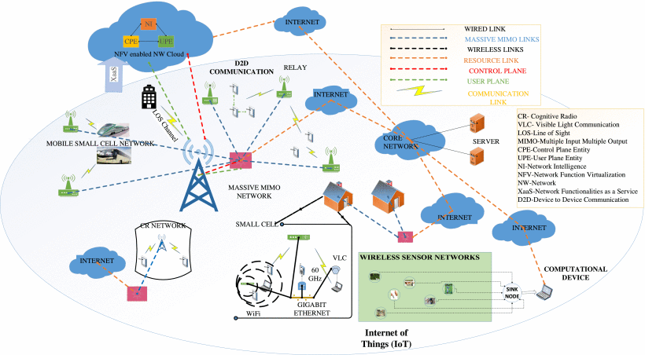
5G network architecture

Slide 9
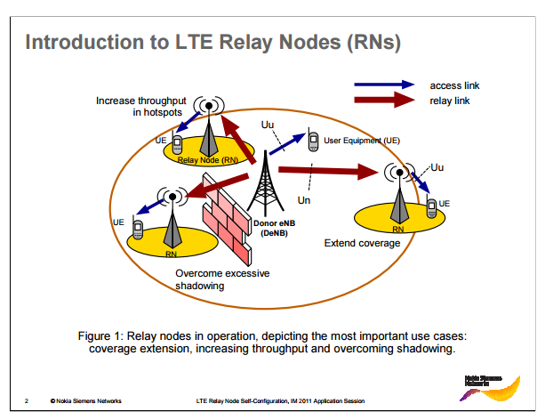
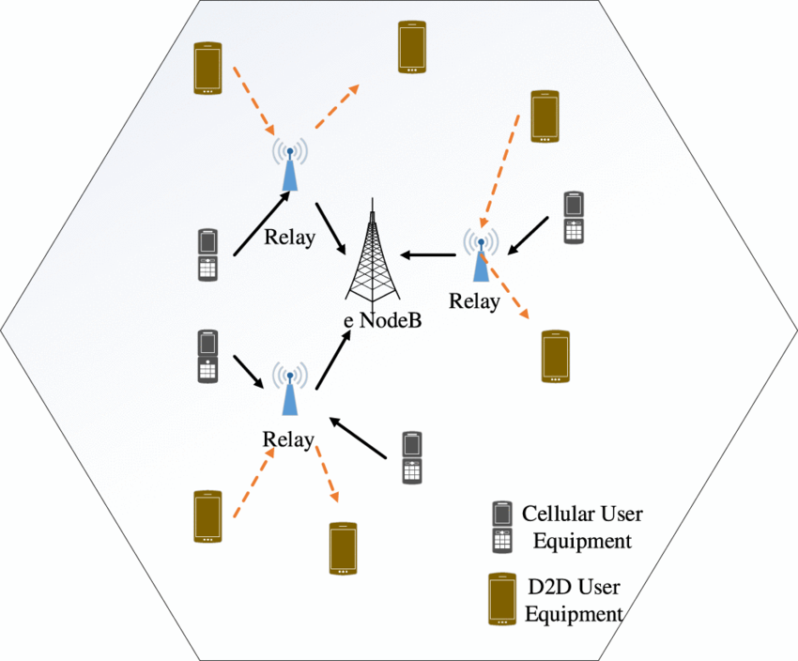
4G LTE vs 5G
4G LTE Node Relay
5G Node Relay

Slide 10
4G LTE vs 5G
4G LTE
5G
Number of connections: Thousands per cell
Bandwidth: 3kHz-6GHz
Latency: 50-100ms
Energy consumption: 1 module for 1 packet (less battery life)
Speed: average of 10-50 Mbps (actual) and 100 Mbps (theoretical)
High-priced data plans because of cell network limits
Number of connections: A million connections per square kilometre
Bandwidth: 3kHz – 300 GHz
Latency: 1ms
Energy consumption: 0.1 modules for 1 packet which is 90% Less energy (more battery life)
Speed: 10Gbps
Cheaper prices: Higher bandwidth broadens cell network limits, no need to charge more money

